Slide 1
Analysis example: integrating PCA and cluster analysis to explore structure of a dataset

Slide 2
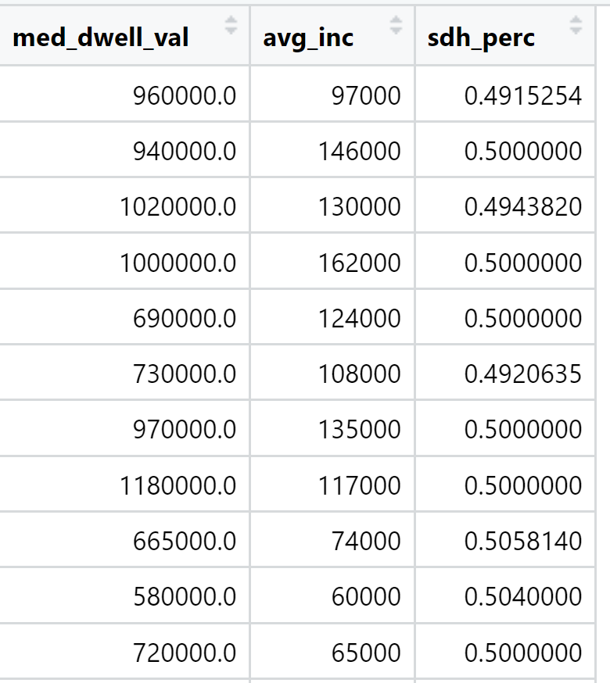
The data

Slide 3
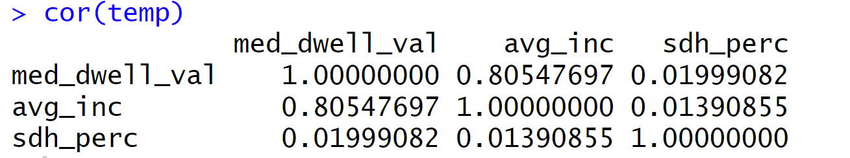
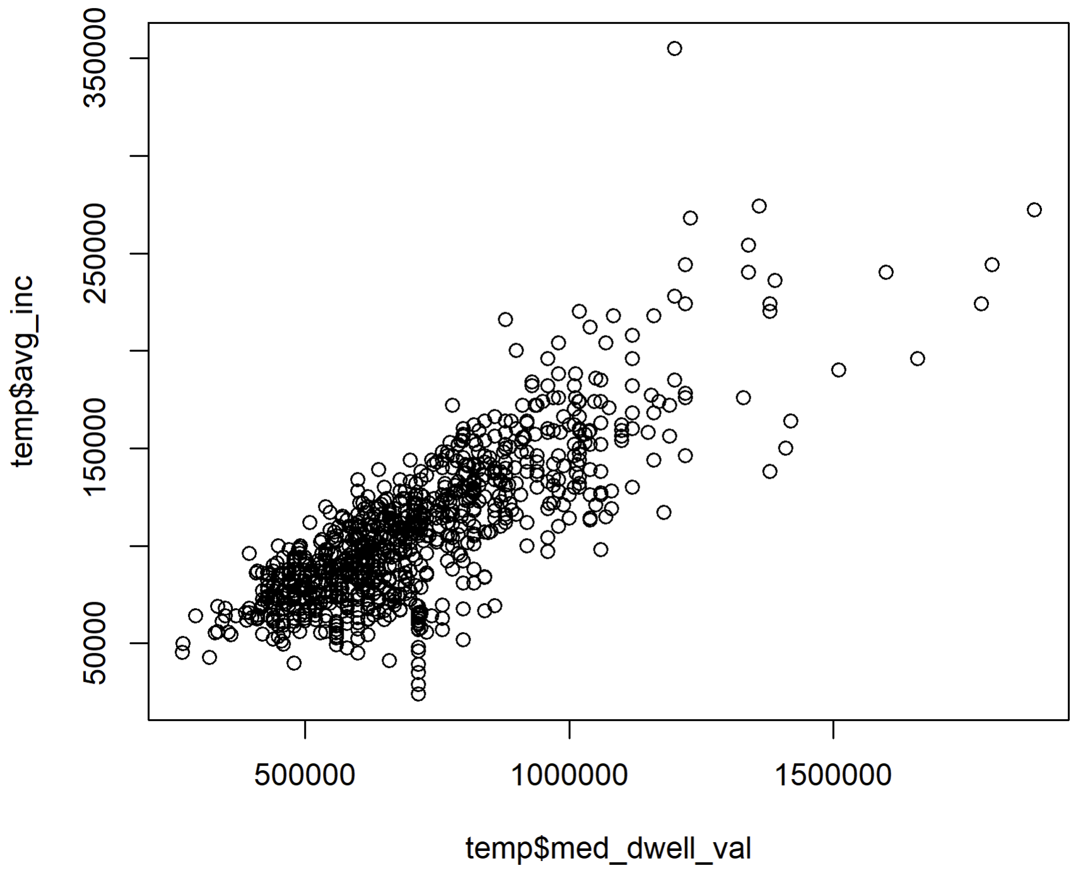
Correlations

Slide 4
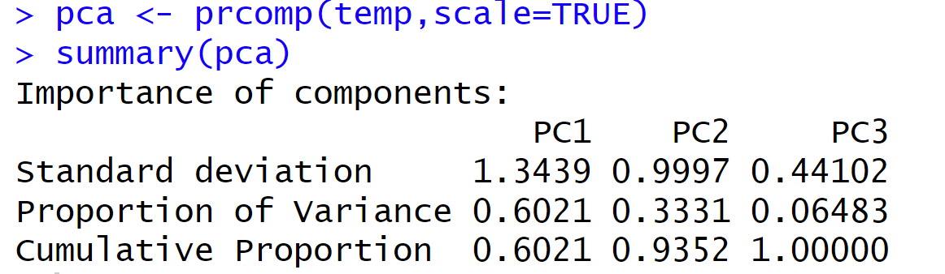
Principal component eigenvalues

Slide 5
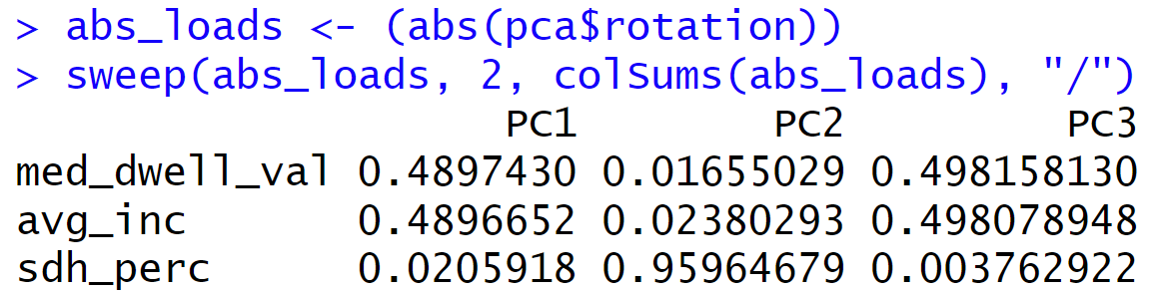
Loadings

Slide 6
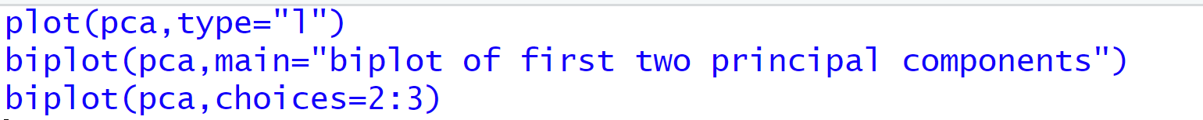
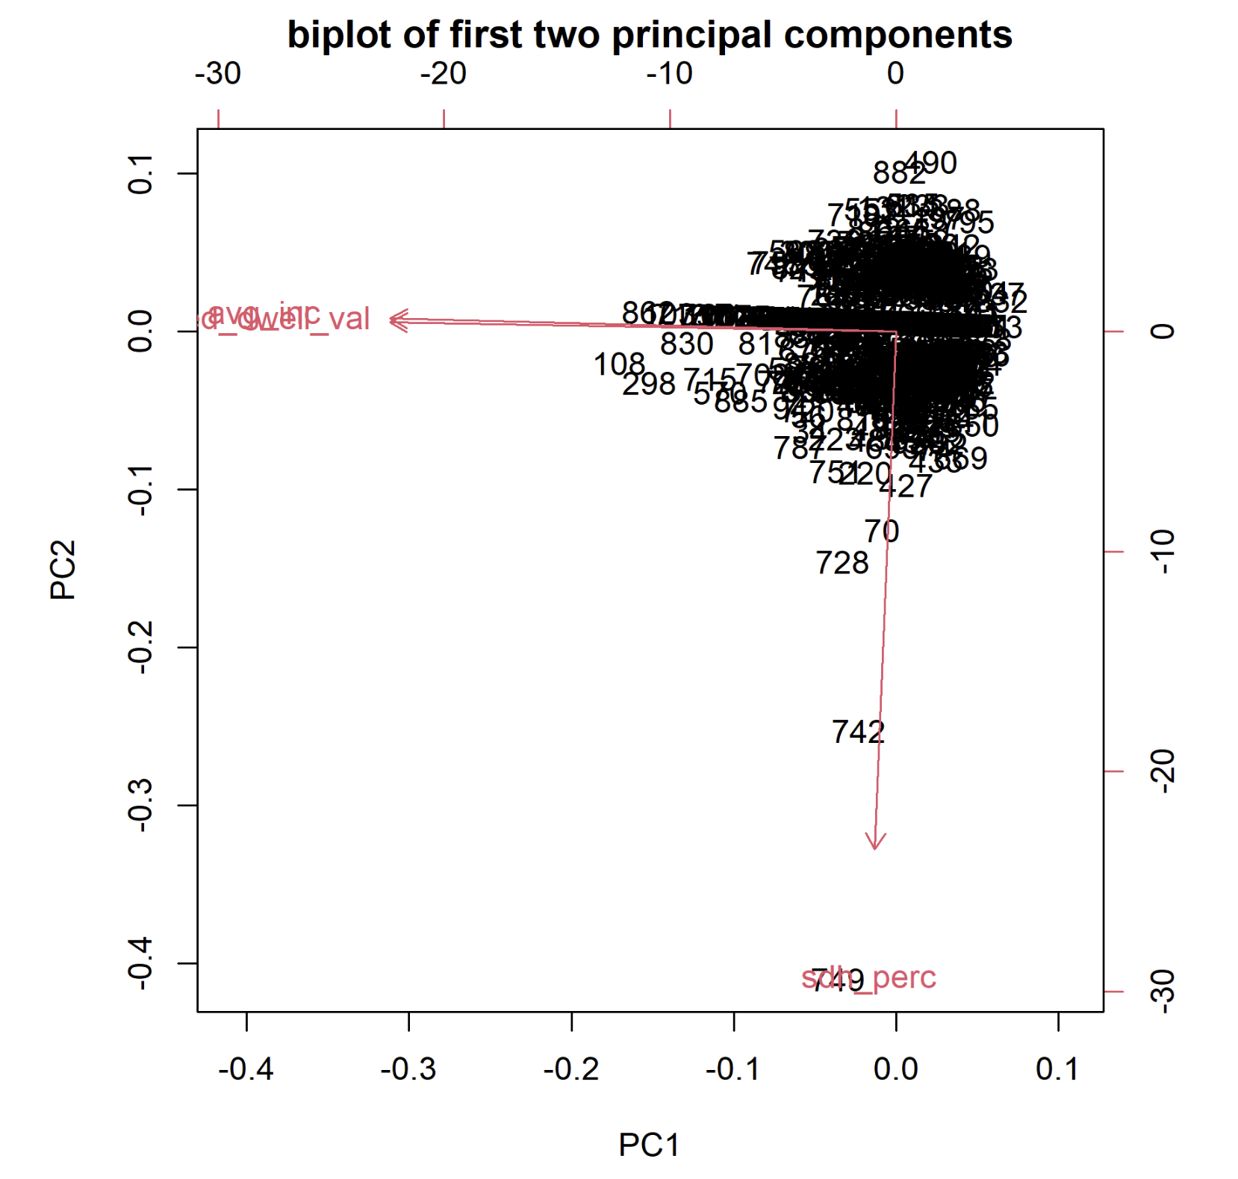
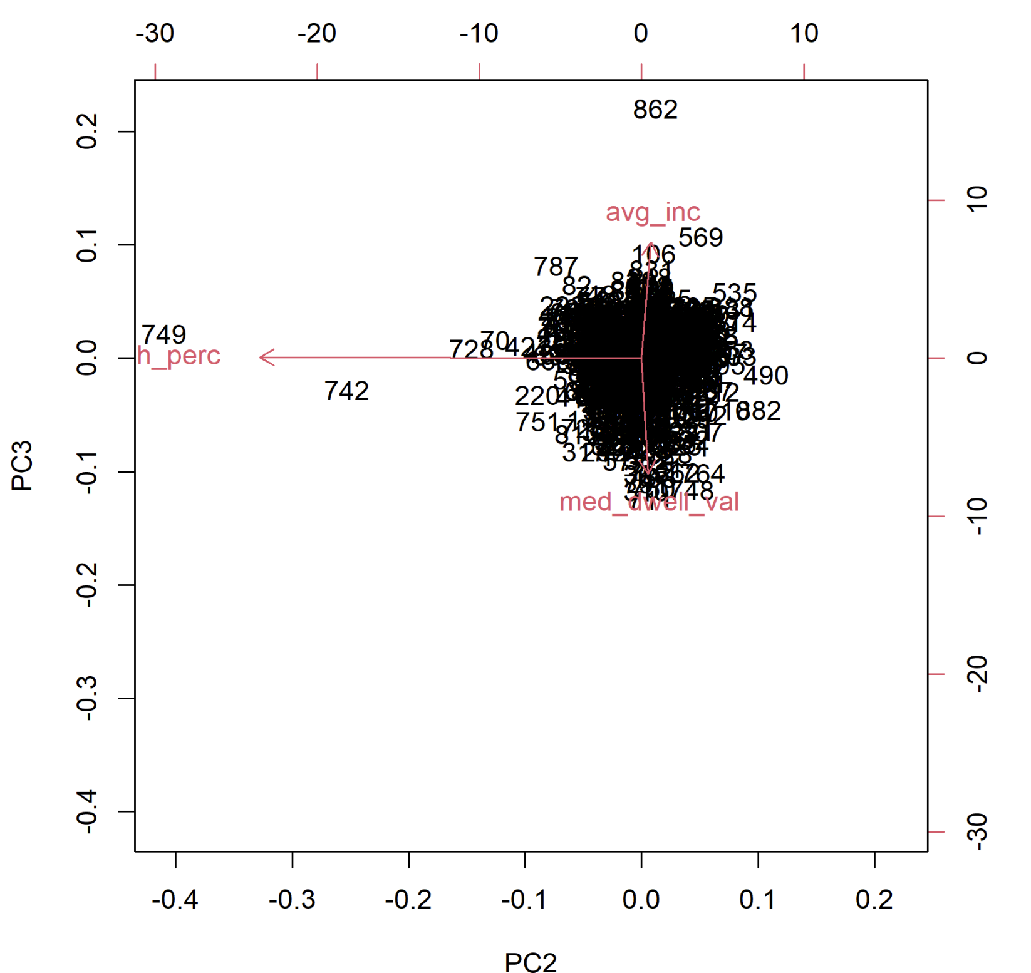
Biplots

Slide 7
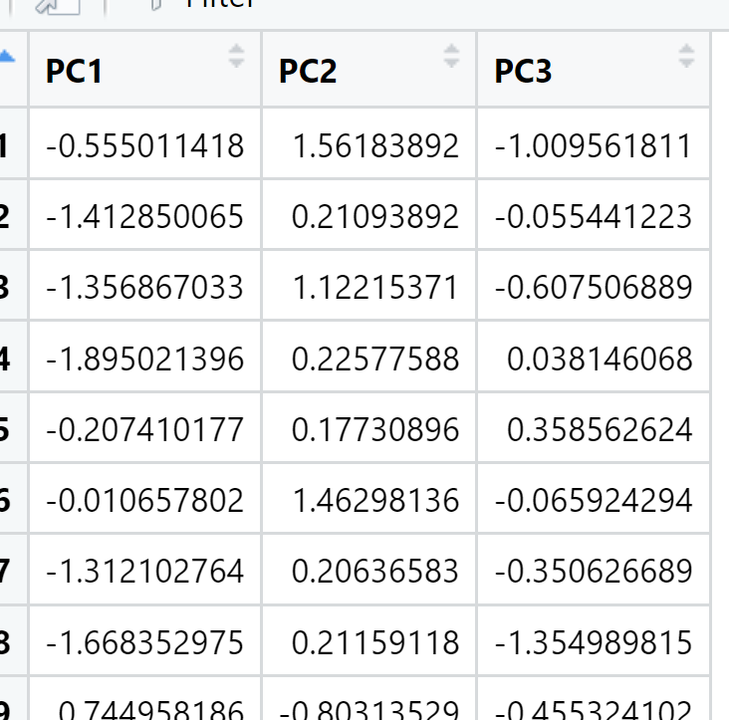
Cluster analysis
Cluster analysis

Slide 8
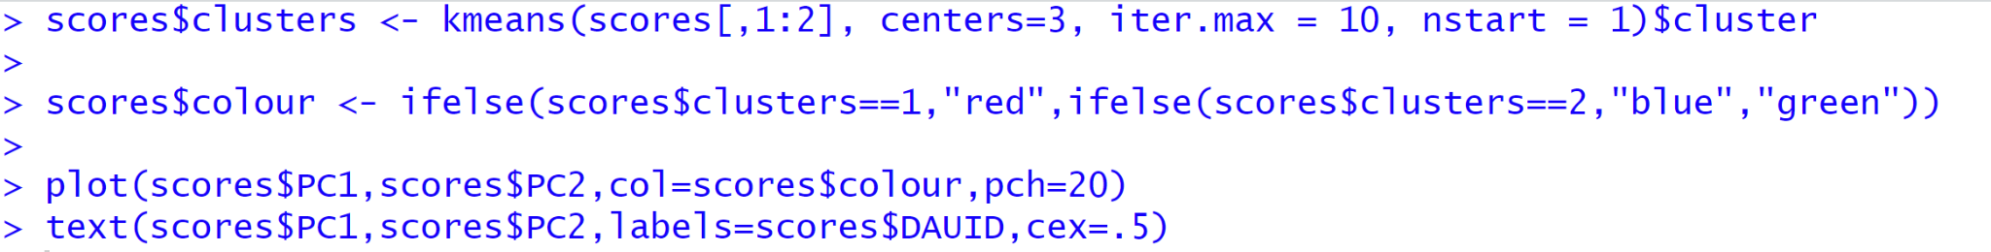
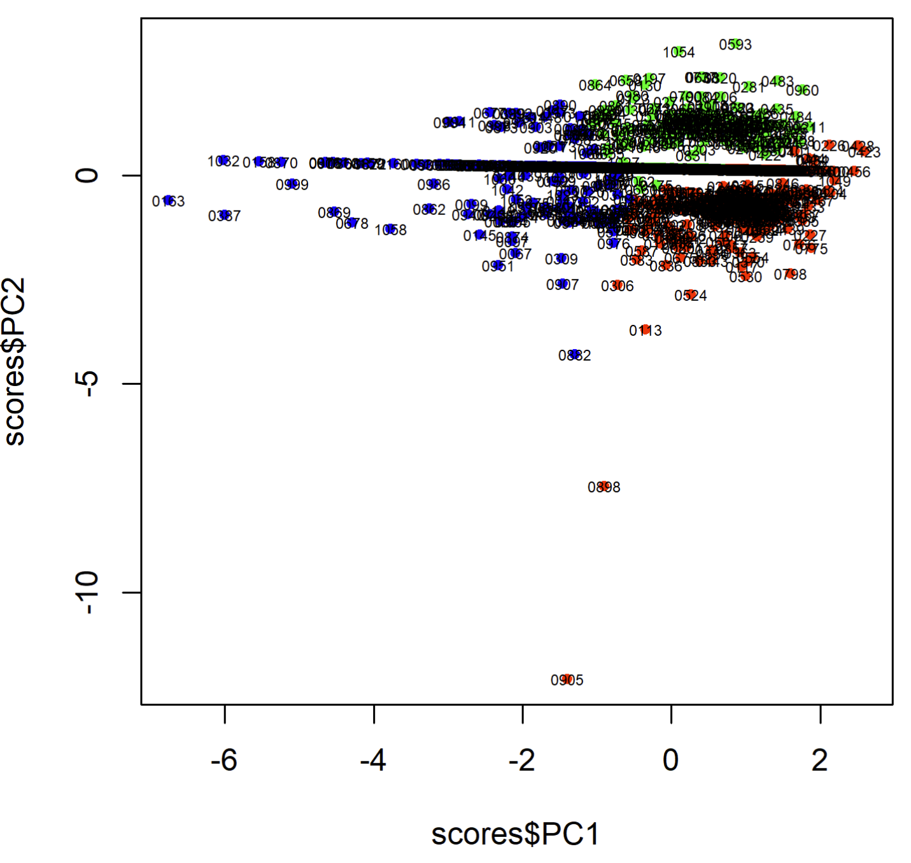
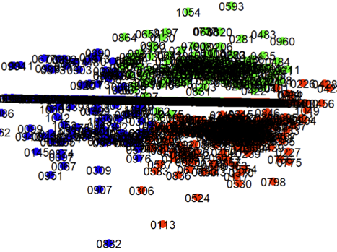
Plotting PCs into clusters

Slide 9
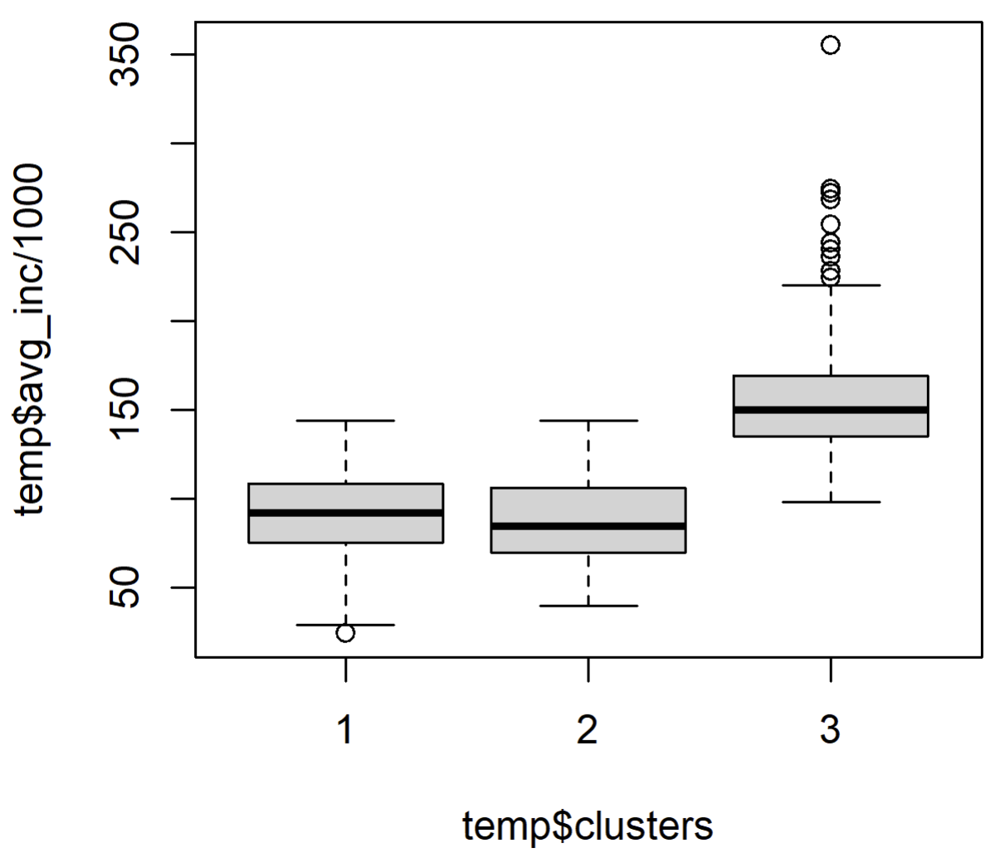
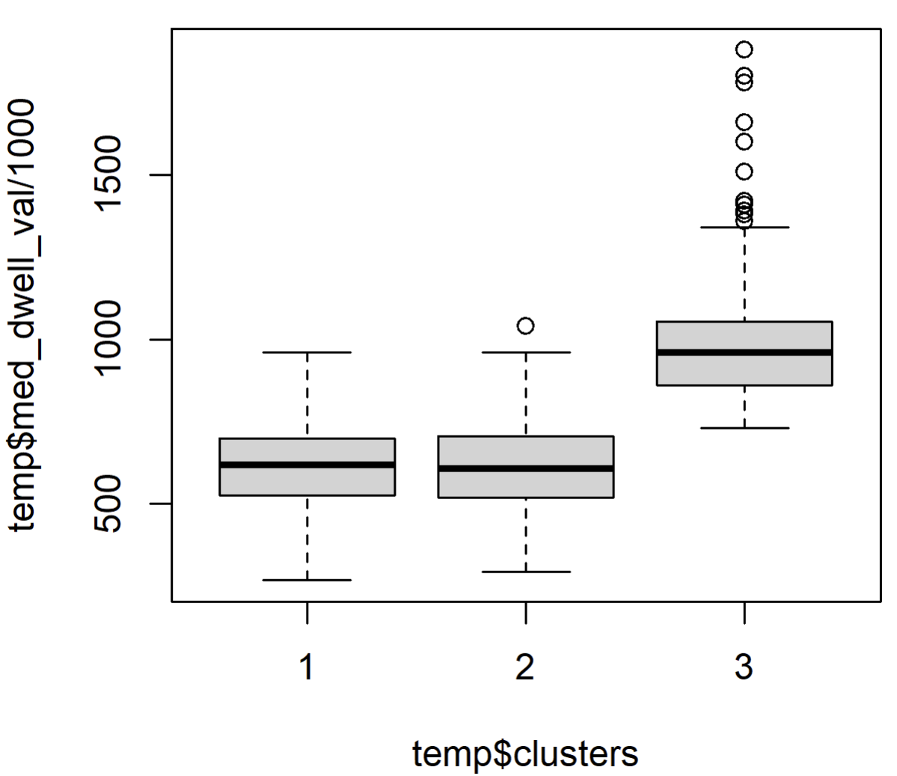
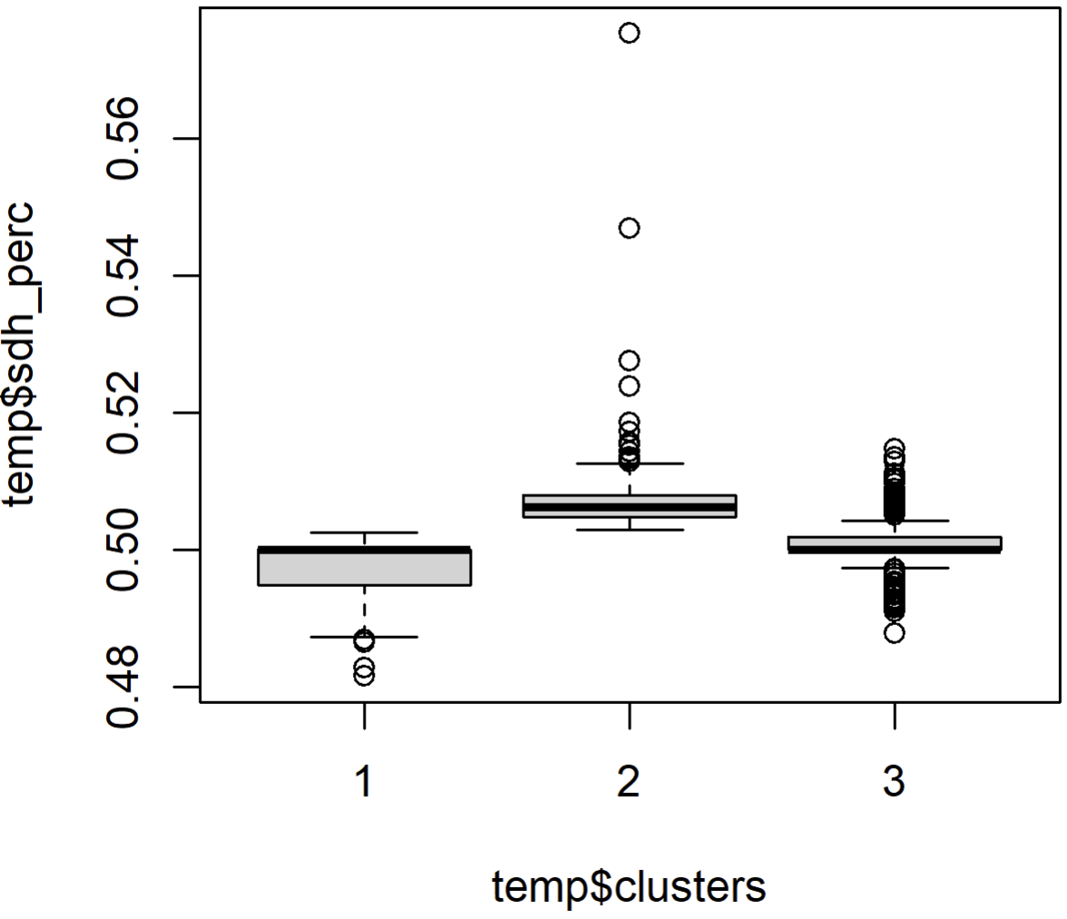
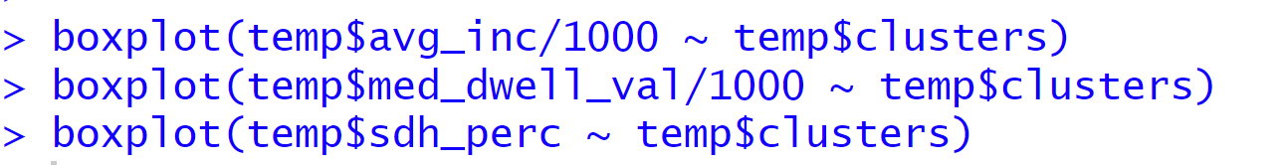
Biplots of clusters and original data
Cluster 3 is wealthier, more valuable homes, more single detached
Clusters 1 & 2 are less wealthy, less valuable homes, but differ in levels of single detached homes

Slide 10
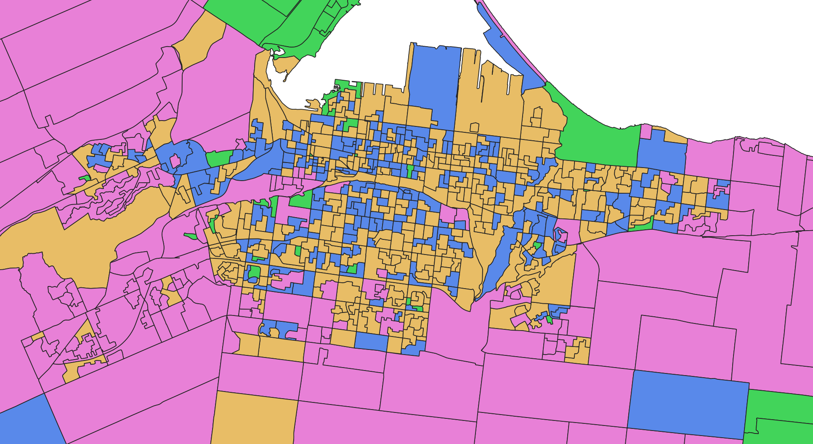
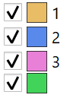
Clusters 1 and 2 don’t really have a spatial pattern, but cluster 3 is more rural and suburban

Slide 11
Agent Based Models (ABMs)
Computational models that simulate the actions and interactions of autonomous agents in order to understand systems. It embodies a ‘bottom-up’ approach to modeling where the properties of a system emerge from the micro-level behaviors of its constituent agents. These agents are typically characterized by a set of attributes, decision rules, and behaviors that define their interactions.
‘Generative’ (Epstein, 2007)
Models of systems based on the assumptions of how they work, and observe whether they predict what we would expect

Slide 12
Example: Deforestation
Inductive
Generative
Create a computational model that simulates the forest ecosystem. Agents in the model might represent trees, logging companies, animals, and local human populations. By running the simulation, scientists observe how deforestation emerges from the interaction of these agents. If the model can generate deforestation patterns that match real-world observations, it may offer an explanations and predictions of the processes
Scientists begin by noting the specific instances of deforestation, measuring the rate at which trees are being cut down, analyzing satellite images over time, etc. From these observations, scientists could induce a general rule or pattern about the causes of deforestation from observing examples of this in data
Deforestation
Urban development

Slide 13
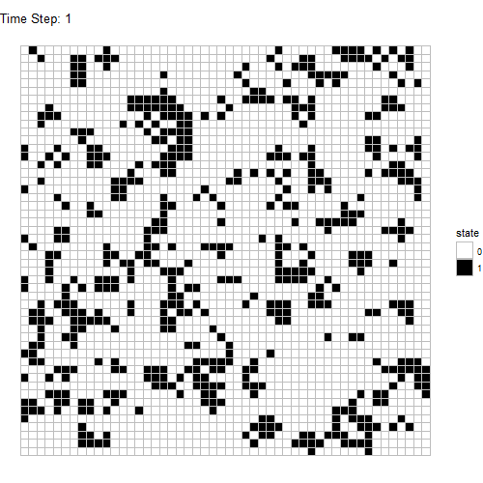
Von Neumann machine
(self-replicating automata)
Cellular automata
Each cell interacts with its four orthogonal neighbors (up, down, left, right) (Von Neumann neighbourhood)
Cell States: Each cell can be either alive (1) or dead (0).
Rules:
Survival: An alive cell remains alive if it has 1 or 2 alive neighbors.
Birth: A dead cell becomes alive if it has exactly 2 alive neighbors.
Death: In all other cases, a cell dies or remains dead.
Conway’s game of life

Slide 14
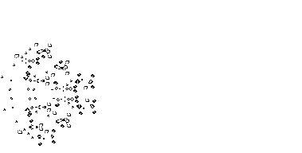

Slide 15
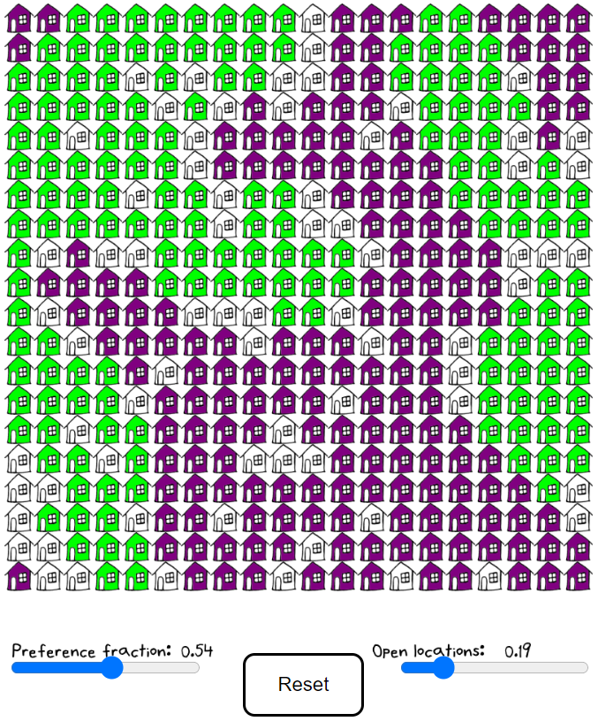
https://www.decisiongame.ca/schelling/

Slide 16
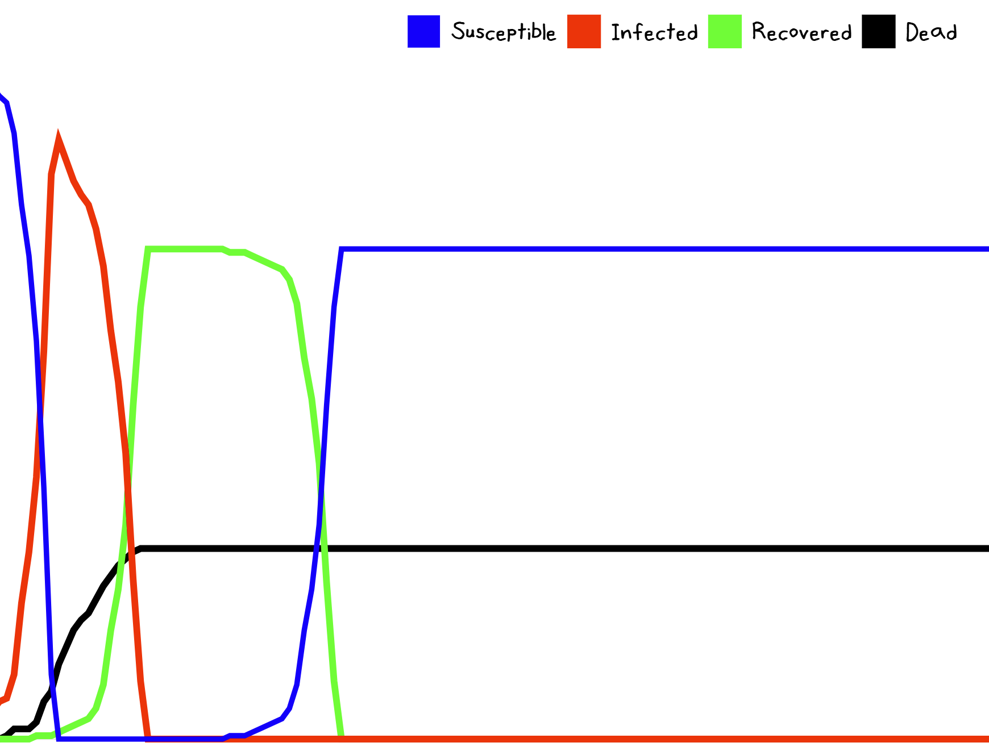
https://www.decisiongame.ca/infection1/

Slide 17
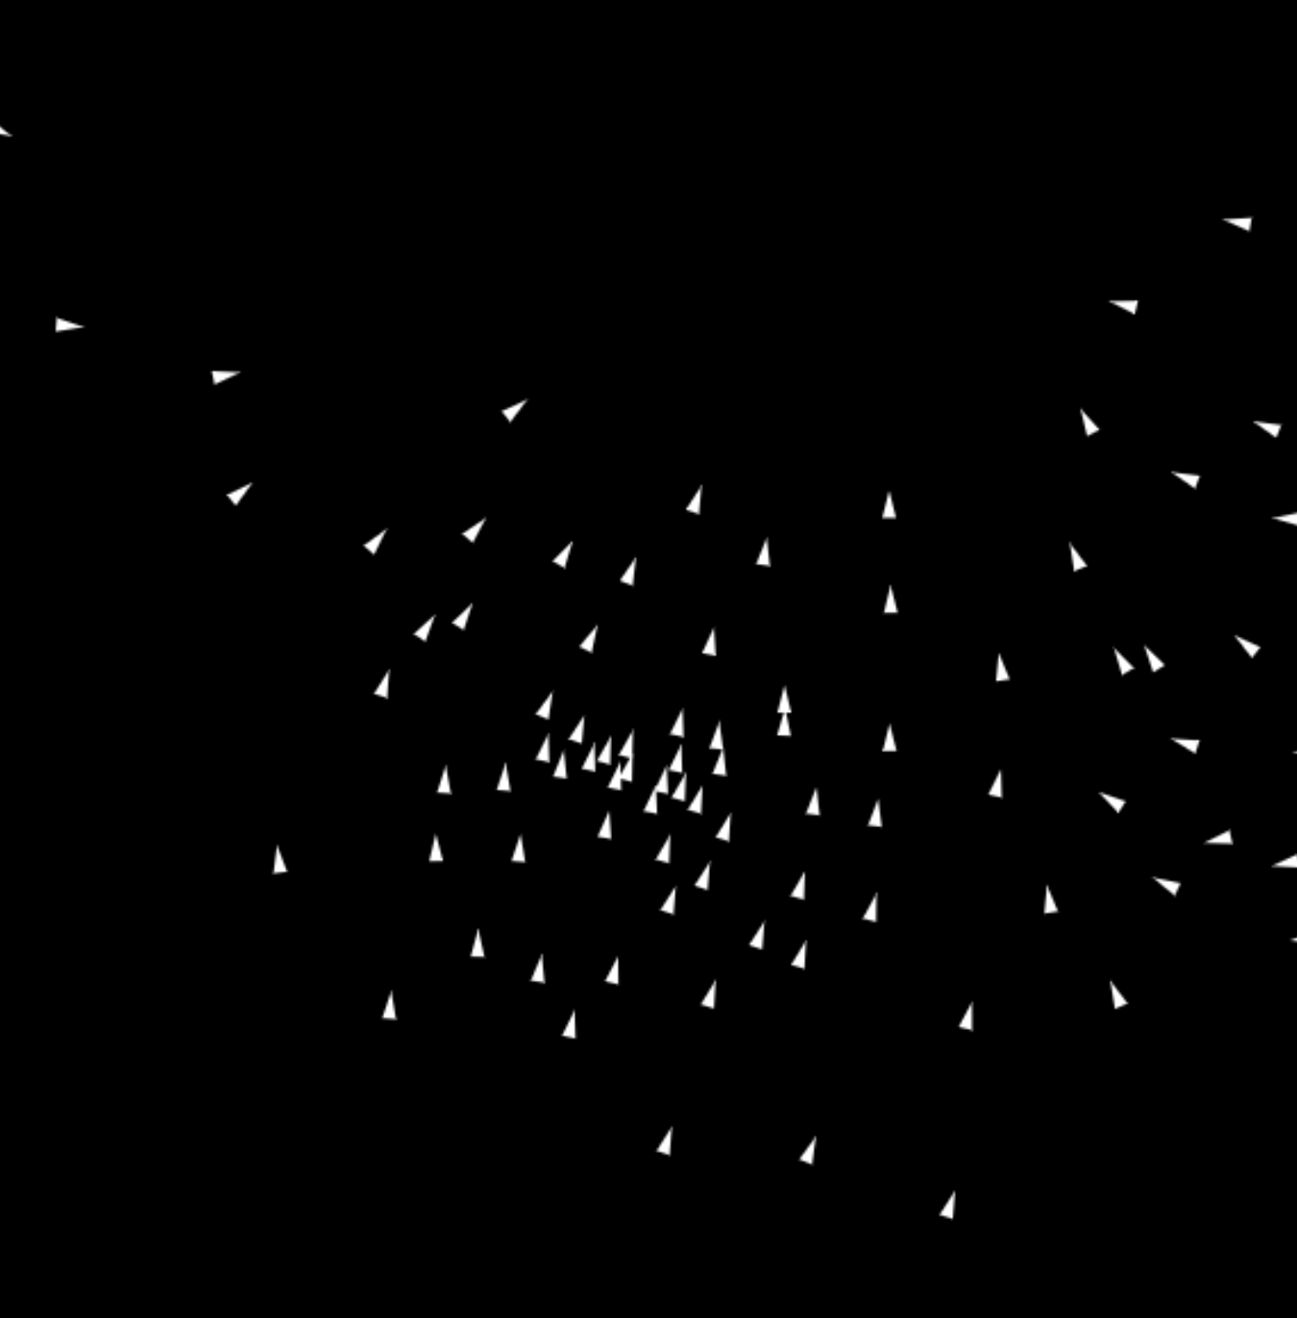
https://www.decisiongame.ca/boids

Slide 18
ABMs and the iterated prisoner’s dilemma
Each agent sees the same payoff matrix
Each agent makes a decision that is rational given the potential responses of the other agent
Each agent has a memory of what happened last time, and places a value on the future based on a discount rate
 | Cooperate | Defect
Cooperate | 3,3 | 1,4
Defect | 4,1 | 2,2

Slide 19
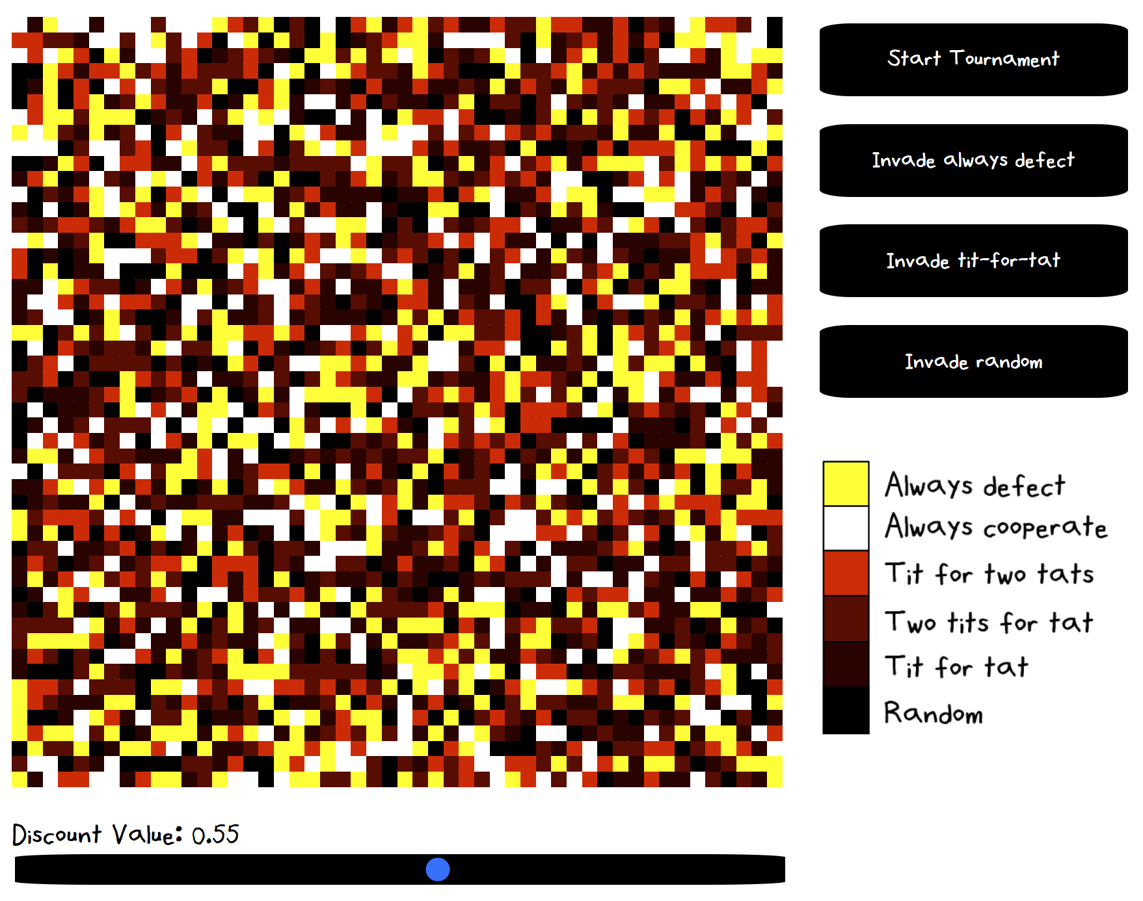
https://www.decisiongame.ca/axelgame/

Slide 20
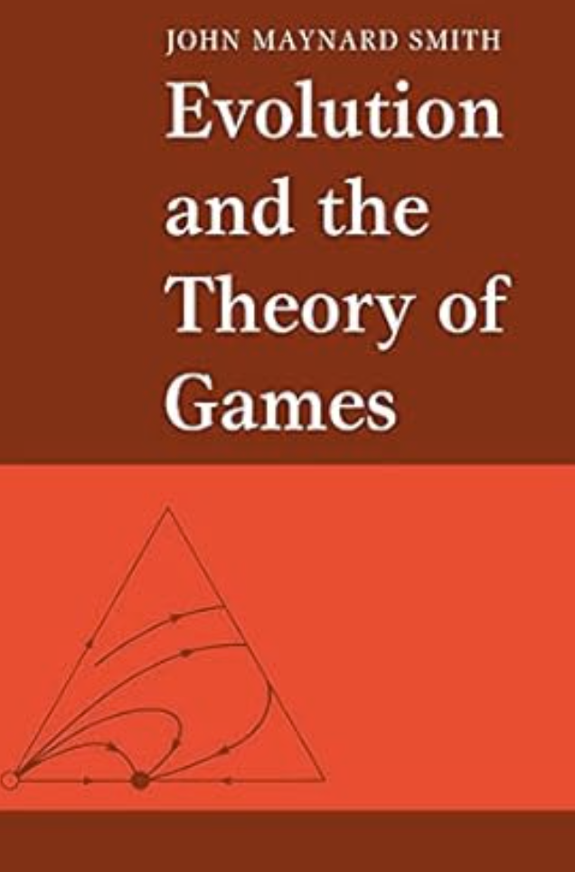
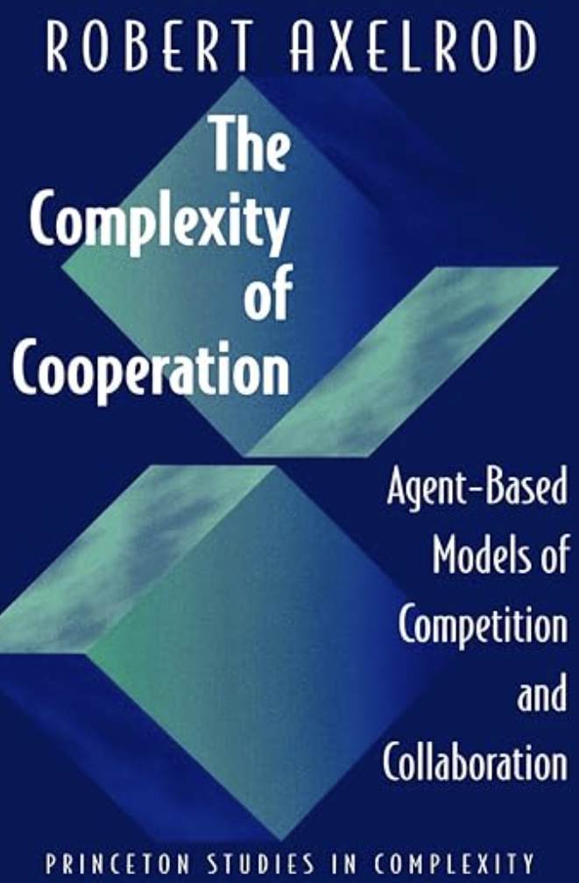

Slide 21
Agent-based models: when might they be useful?
Transportation: model interactions of agents in response to policy change
Health: model disease, health care systems, insurance
Economics: model markets and economies
Landscape Evolution: simulate the process of erosion, sediment transport, and deposition over time
Hydrology: understand the movement and flow of water across landscapes
Resource management and regulation: water management, flood control, pollution regulation, pollution markets (cap and trade, pollution pricing)
system is too complex to model analytically
multiple agents with interacting decisions
modelling processes and systems rather than their parts

